Slide 1
Backdoors
Shoutout to Matthew Chan for letting me change these slides up

Slide 2
What are backdoors?
Backdoors: a point of access where users (authorized or not) gain access to root privileges on a system, usually to exploit it
can be used for good/bad stuff (either companies or hackers use)
many instances are opened by bad peeps
THEY MUST STAY IN (persistence is key)
Notes:
1st bullet: elaborate on how companies purposely place backdoors sometimes
“rabbit hole”: once you find one, there may be many more; tie this to the idea of staying in the system

Slide 3



Illustrating Backdoors

Slide 4
Types of Backdoors
Bind shell: the attacker targets the user (victim) by listening on an open port and connecting to it (their shell)
THEY connect to YOU
inbound traffic
Reverse shell: the attacker opens up a listener port while the user connects to said port (access to the shell)
YOU connect to THEM
outbound traffic
Webshell: reverse shell but specifically on websites (LAMP)
How do they do it?
Insecure remote services: pretty much just hackers exploiting services (SSH, Samba, Telnet, Netcat) to connect onto device
That’s why it is importante to secure your servers w/ firewalls and configs
Notes:
Netcat ofc is vulnerable

Slide 5
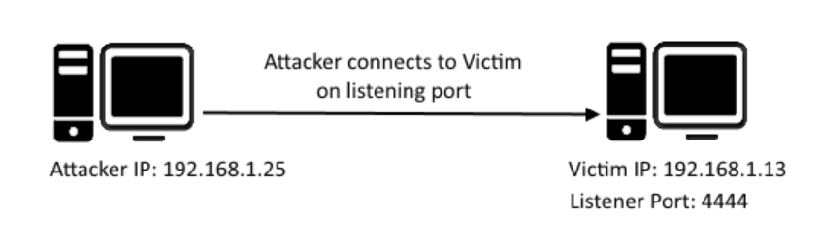
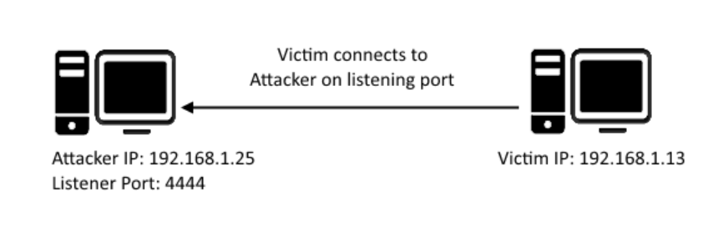
Diagrams for Healthy Learning woohoo
Bind shell/Shell bind
Reverse shell
Notes:
animations will play to identify which one is which (ask class which one is which)

Slide 6

How to prevent backdoors?
Just let them use the front door (duh)
Notes:
uhhh if this is taken in all seriousness please don’t it is a MEME slide (just move on after)
add some info (teachers) why this shouldn’t be the case (quite obvious but you know)

Slide 7
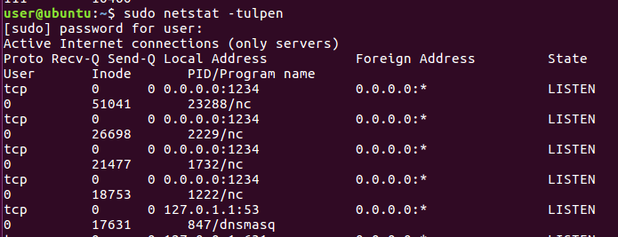
How to actually detect/remove backdoors
Methodology: It really up to personal preference, but here’s Ryan’s tips
Find your ports
Find what’s running on them
If it’s something nasty, remove it!
Else move on
Notes:
Backdoors are not obvious, they are hidden!

Slide 8

How do I find my open ports?
netstat -tulpen
Covers TCP and UDP protocols
shows ports including listening ones
Shows IPs they are being operated on + port #’s
*Sidenote: netstat could be janky if it is compromised by a rootkit*
NMAP (don’t be scared my dear children)
Covers steps 1 and 2
Same stuff like netstat, but not compromised by rootkit
Can also show services on computer
nmap -sV (service version) -v (verbose) [IP] I
Notes:
Rootkit: malicious software that masks as other safe programs
How to fix it? We will get to it on Thursday.

Slide 9
Finding services and processes
ps aux (calls the process viewer)
a - all, u - show process user, x - show processes not run on terminal
Rightmost category holds the binaries/commands being run
Also reveals PIDs, which can be used for killing them off
ps axjf shows the hierarchy tree of processes
If you know the port of a running process, use fuser [port #]/[tcp/udp]
Reveals PIDs

Slide 10

Kill the process running it now that you know the PID
sudo kill [PID]
Block the port if necessary
sudo ufw deny [port]
Check the crontabs (/etc/cron.d, /etc/crontab, /var/spool/cron/crontabs)
***** [cmd] means it is running every minute
Remove these lines
Maybe even remove the file
/etc/rc.local may run stuff to (on startup)
Server folders can also be a point (i.e. /var/www/html for LAMP)
Now the destroy the backdoor

